Slide 1

Making a Latin Translator
Sophia Furfine

Slide 2
Why can’t Google translate Latin like it does so many other languages?

Slide 3
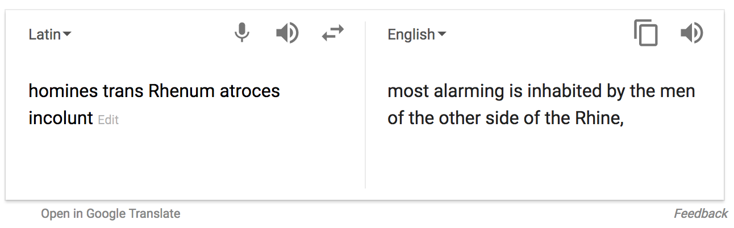
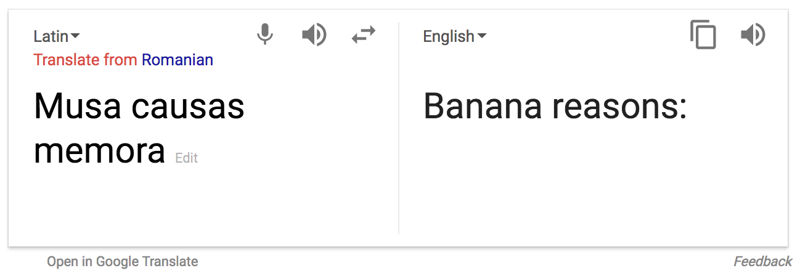
Why can’t Google translate Latin like it does so many other languages?

Slide 4
Why doesn’t word-by-word translation work?

Slide 5
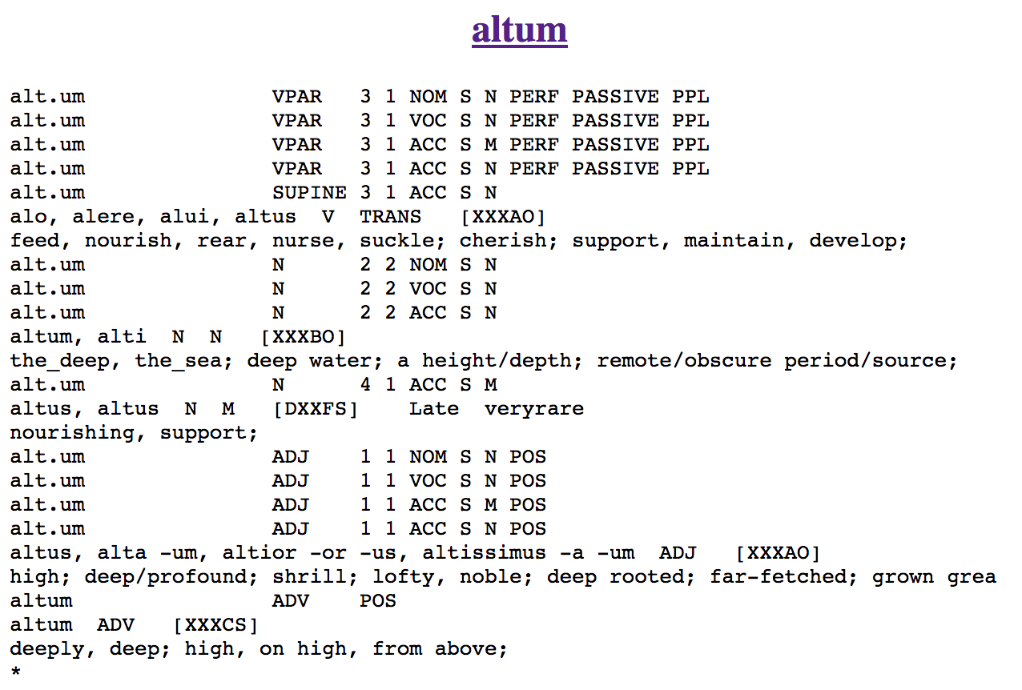
Why doesn’t word-by-word translation work?

Slide 6
Building sentence trees – works!

Slide 7
Building sentence trees – works!
bona
puella
sedet
sub
abore

Slide 8
Building sentence trees – works!
bona
puella
sedet
sub
abore
Subject
plural
“goods”
Subject
singular
“girl”
Verb
singular
“sits”
Preposition
“under”
Prep phrase
noun
“tree”

Slide 9
Building sentence trees – works!
bona
puella
sedet
sub
abore
Subject
plural
“goods”
Subject
singular
“girl”
Verb
singular
“sits”
Preposition
“under”
Prep phrase
noun
“tree”

Slide 10
Building sentence trees – works!
bona
puella
sedet
sub
abore
Subject
plural
“goods”
Subject
singular
“girl”
Verb
singular
“sits”
Prepositional phrase
“under the tree”

Slide 11
Building sentence trees – works!
bona
puella
sedet
Subject
plural
“goods”
Subject
singular
“girl”
Verb
singular
“sits”
sub
abore
Null direct object
Prepositional phrase
“under the tree”

Slide 12
Building sentence trees – works!
bona
puella
sedet
Subject
plural
“goods”
Subject
singular
“girl”
Verb
singular
“sits”
sub
abore
Null direct object
Prepositional phrase
“under the tree”

Slide 13
Building sentence trees – works!
bona
puella
sedet
Subject
plural
“goods”
Subject
singular
“girl”
Verb
singular
“sits”
sub
abore
Null direct object
Prepositional phrase
“under the tree”

Slide 14
Building sentence trees – works!
bona
puella
sedet
Subject
plural
“goods”
Subject
singular
“girl”
Verb
singular
“sits”
sub
abore
Null direct object
Prepositional phrase
“under the tree”

Slide 15
Building sentence trees – works!
bona
puella
sedet
sub
abore
Direct
object
plural
“goods”
Subject
singular
“girl”
Verb
singular
“sits”
Preposition
“under”
Prep phrase
noun
“tree”

Slide 16
Building sentence trees – works!
bona
puella
sedet
sub
abore
Direct
object
plural
“goods”
Subject
singular
“girl”
Verb
singular
“sits”
Preposition
“under”
Prep phrase
noun
“tree”

Slide 17
Building sentence trees – works!
bona
puella
sedet
sub
abore
Direct
object
plural
“goods”
Subject
singular
“girl”
Verb
singular
“sits”
Prepositional phrase
“under the tree”

Slide 18
Building sentence trees – works!
puella
sedet
Subject
singular
“girl”
Verb
singular
“sits”
sub
abore
bona
Prepositional phrase
“under the tree”
Direct
object
plural
“goods”

Slide 19
Building sentence trees – works!
puella
Subject
singular
“girl”
sedet
Verb
singular
“sits”
sub
abore
bona
Prepositional phrase
“under the tree”
Direct
object
plural
“goods”

Slide 20
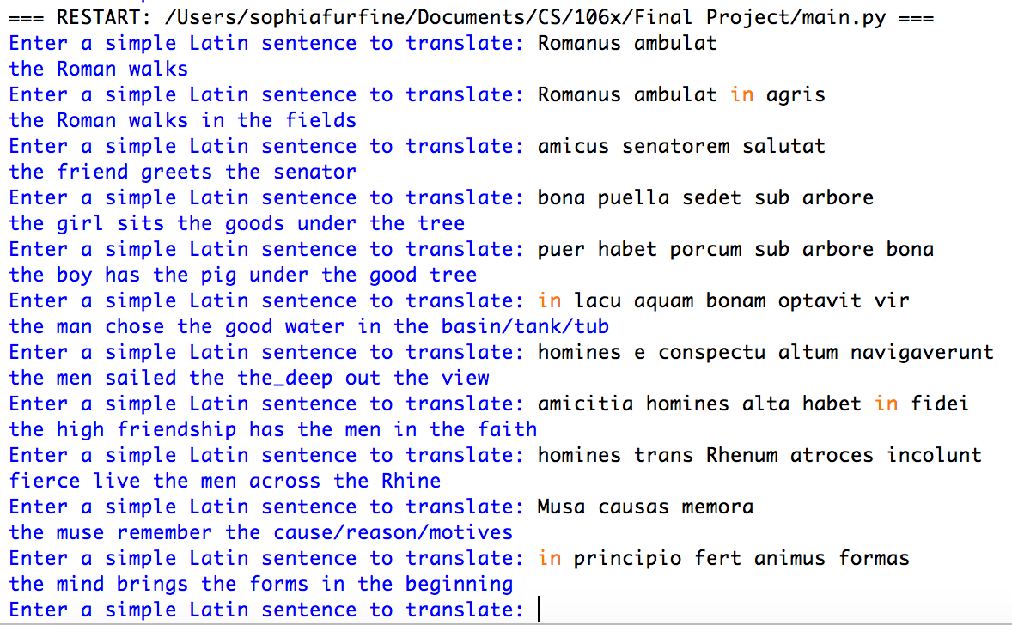
Results

